Slide 1
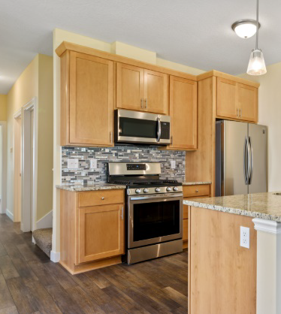
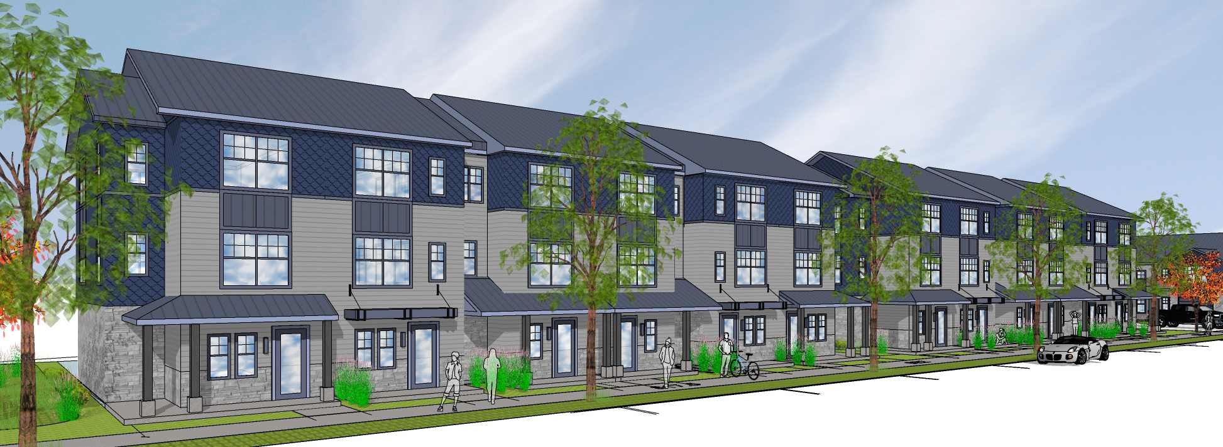
Homeownership Housing in Minneapolis

Slide 2
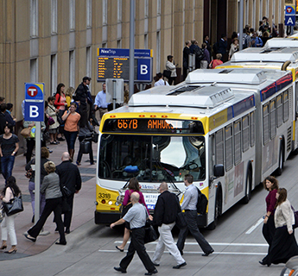
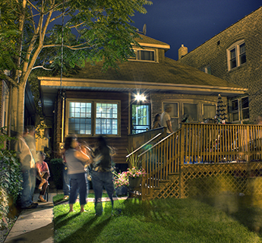
Why is this program important?
Minneapolis 2040 Goals
Eliminate Disparities: In 2040, Minneapolis will see all communities fully thrive regardless of race, ethnicity, gender, country of origin, religion, or zip code having eliminated deep-rooted disparities in wealth, opportunity, housing, safety, and health.
More residents and jobs: In 2040, Minneapolis will have more residents and jobs, and all people will equitably benefit from that growth.
Affordable and accessible housing: In 2040, all Minneapolis residents will be able to afford and access quality housing throughout the city.
Climate Resilience: In 2040, Minneapolis will be resilient to the effects of climate change and diminishing natural resources and will be on track to achieve an 80% reduction in greenhouse gas emissions by 2050.
Notes:
The 2040 comprehensive planning process in Minneapolis did extensive engagement with residents to develop a strategic vision for the City. Minneapolis Homes programs are tailored to implement the vision of Minneapolis 2040 goals, which include eliminating disparities, growing our City equitably, providing affordable and accessible housing throughout the City, and achieving climate resilience.

Slide 3
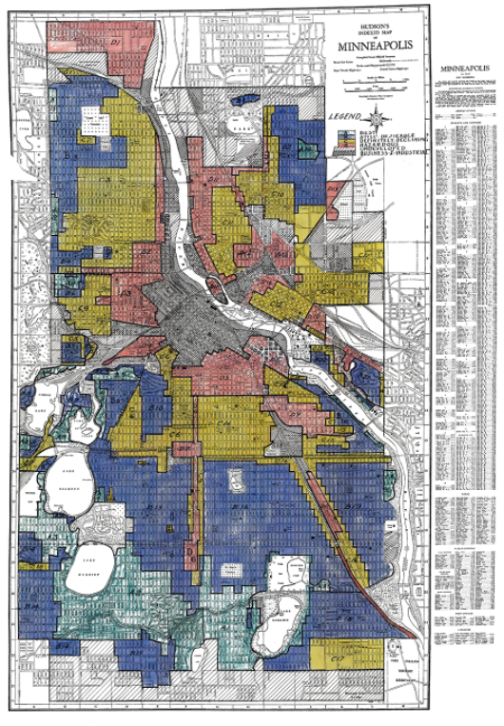
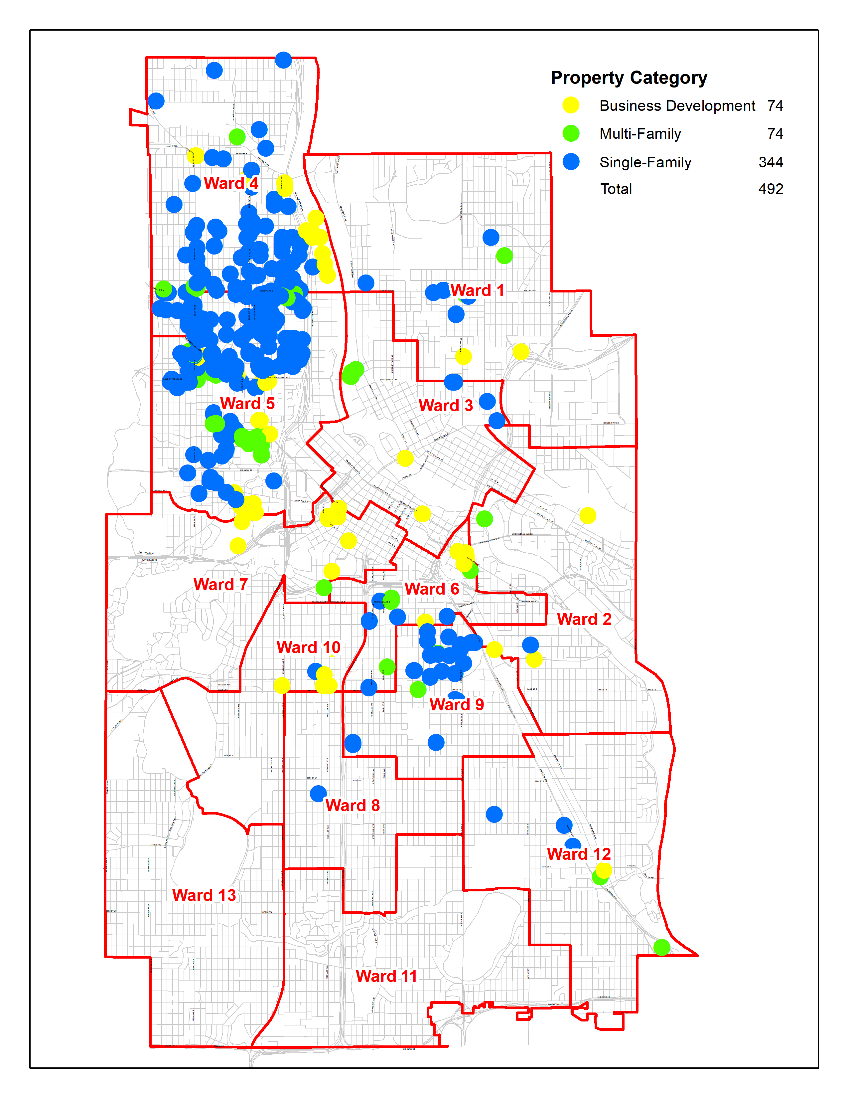
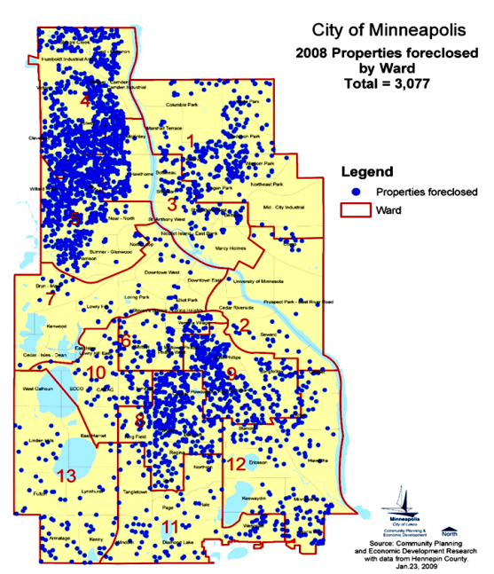
Racist policies continue to impact Minneapolis
FHA redlining map 1930’s
City of Minneapolis
development land 2022
Foreclosure map 2008
Notes:
The Twin Cities region has some of the most pronounced racial disparities in homeownership in the country. Disparities are due to centuries of public policy that excluded Black, Indigenous, Hispanic, and Asian households from opportunities to build generational wealth. The wounds of these policies are still present in our social fabric – a majority of the city owned property we are trying to develop today are located in the communities where redlining concentrated people of color communities and devalued property, and more recently where the impacts of subprime lending and the foreclosure crisis were most pronounced. Today, North and South Central Minneapolis are where the newest trend of investor driven purchases of 1-4 unit homes and rapidly appreciating home values out of line with people’s incomes are making the opportunities of homeownership further out of reach.
As our Minneapolis Homes team sought to build a strategy for developing city-owned land, we directly engaged with community members through a series of over 25 workshops that engaged 1,000 residents, focused within North and South Central Minneapolis where both our land ownership and people of color communities are most concentrated.

Slide 4
Eliminating racial disparities in homeownership
means nearly 13,000 people of color renter households in Minneapolis must purchase a home
Notes:
In Minneapolis, 57% of White Minneapolis households own their homes (43% of White households are renters), compared to 19% of Black Minneapolis renter households – meaning there is a 38% disparity in ownership within the Black population of Minneapolis. When the disparity rate of 38% is multiplied with the total 21,810 of Black Minneapolis renters identified in Census bureau data, it means 8,287 Black households must become homeowners in order to eliminate the disparity in ownership. The same exercise can be repeated for each racial/ethnic group that we have Census data for, meaning our overall need is serving nearly 13,000 Black, Indigenous, or People of Color (BIPOC) renter households to eliminate racial disparities.

Slide 5
Why do we need to create affordable units?
Notes:
We compared the affordable home sales in 2018 to the number of renters in 2018 for each income bracket.
In the blue bar are the homes that sold in 2018 affordable to households at different AMI levels. In orange are the number of people of color renters and in grey are the number of White renters
The biggest conclusions we came to from this data was that if we need to serve 13,000 BIPOC renters we should focus our efforts on households below 80% AMI, for two reasons:
1) the odds of serving people of color households are greater within each income bracket below 80%. There are 4 white households for every one person of color household above 80% AMI, below 30% AMI there are 2 people of color households for every one white household.
2) there are very few affordable homeownership opportunities that serve households below 50% AMI and virtually none below 30% AMI, but over 70% of BIPOC renters have incomes at these levels. This is a huge mismatch in supply vs demand.

Slide 6
What does AMI mean?
Line up all the incomes in the 11-County Twin Cities Metro – area median income is right in the middle ($104,900)
Area Median Income is established by the US Department of HUD and updated annually mid-year
2021 HUD AMI limits 11-county metro | 1 person | 2 person | 3 person | 4 person | 5 person
30% AMI | $22,050 | $25,200 | $28,350 | $31,450 | $34,000
50% AMI | $36,750 | $42,000 | $47,250 | $52,450 | $56,650
80% AMI | $55,950 | $63,950 | $71,950 | $79,900 | $86,300
Notes:
Minneapolis Homes programs were recently realigned to focus intentionally on households below 80% AMI. It’s important to note that area median income adjusts for household size. So a one person household making $56,000 is considered an 80% AMI household, but a 5 person household making the same amount is considered a 50% AMI household. The more people in a household, the more bedrooms they need and the more purchasing power they have, so when we subsidize the construction of a housing unit we adjust based on bedroom size and also by income tier.

Slide 7
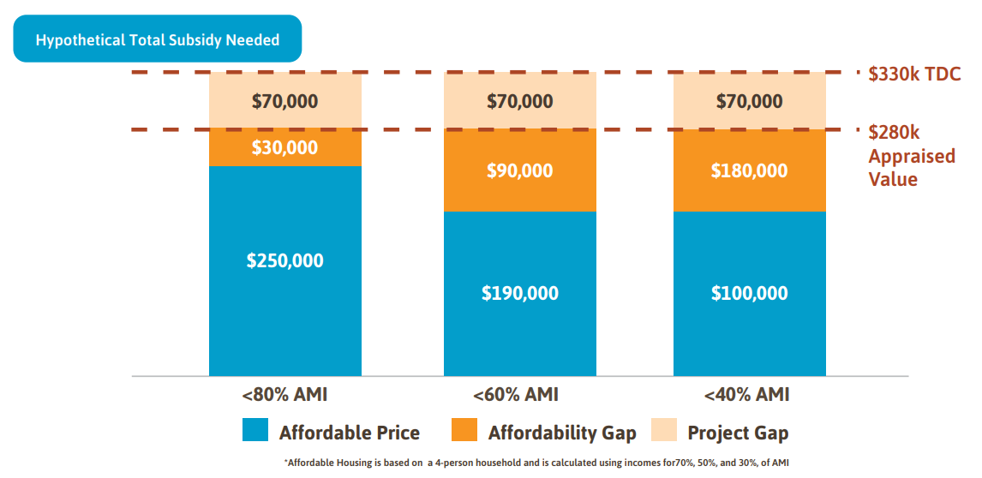
What is the subsidy need?
Notes:
Now I want to talk to you about subsidy need. There are two types of subsidy our development financing program provides.
In 2019, it cost about $330,000 to construct a new unit of housing. At the time of our study, the median sale price for a new construction house was about $350,000 throughout the City – but in some areas of the City, particularly the areas that were historically redlined and impacted by the foreclosure crisis, appraised values for the same new construction house are lower. In North Minneapolis at the time of our study appraised value was about $280,000. That difference between what it costs to build and the value of the home created is called development or project gap – but for the City providing assistance to fill that gap no developer would pursue doing the project, because they’d be losing $70,000 on the project.
The second type of gap is affordability gap. Our programs are designed to serve three income tiers – households between 61-80%, households between 41-60%, and households below 40% AMI.
In blue on this chart is what someone in the middle of each income tier could afford to finance as a first mortgage when we did our market study in 2019 – using an assumption that households are paying around 30% of their income towards a monthly payment that includes principal, interest, taxes, and insurance.
When that cost is compared to the amount a homebuyer can afford to pay (the amount in blue) then there’s an affordability gap for that homebuyer. In other words, if a homebuyer can only afford to pay for a first mortgage of $250,000, they’ll need support, either a grant or a loan with no monthly payments, to be able to reach that home value at $280,000. And that support is greater for households below 60% or 40% of AMI. When the City makes a substantive investment in affordability gap, we typically enroll a program in a perpetually affordable housing model – so that our deep investment can serve multiple homebuyers over time, and provide very low income renters with a wealth building bridge to traditional homeownership.

Slide 8
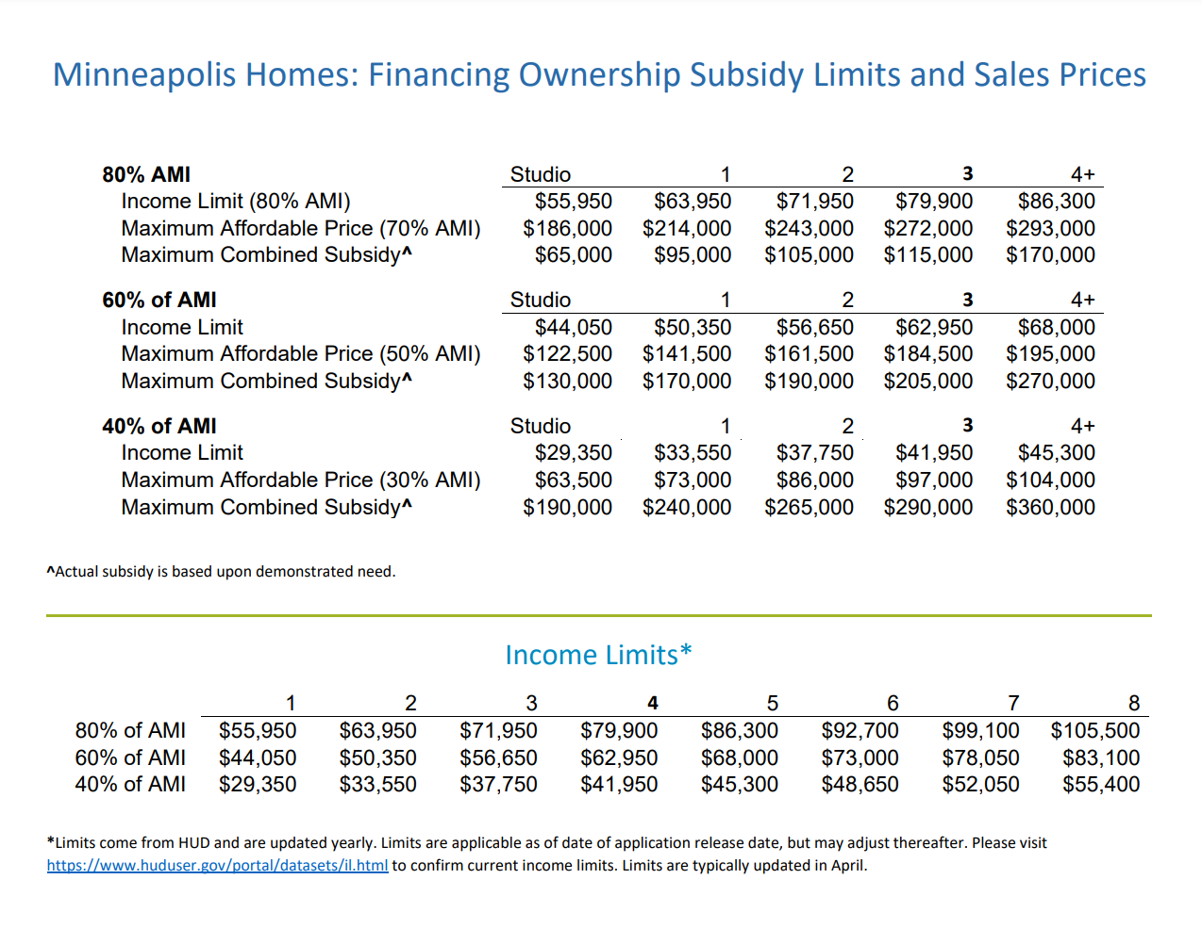
Notes:
Here’s a more complicated version of the chart I just showed, based on 2021 income limits and development costs.
If we’re trying to serve a 4 person household between 41-60% AMI, then we’re going to try to build a 3 bedroom home and price it at at 50% AMI, or $184,500. Then we’ll cap the income limit for that unit at 60% AMI, or $62,950. In order to construct that home, we’ll provide a maximum subsidy of $200,000. The combination of our subsidy and the affordable price sets the maximum cost that unit can be developed for – if it costs less or a homeowner can afford more, then the city’s subsidy is paid back and recycled in future funding rounds.
In cases where we’re contributing 20% or more of the value of a home to make it affordable to a household, we implement a perpetual affordability model.

Slide 9
Perpetual Affordability
Retention: All subsidy is retained in the home
TDC - $330k
$289k
$60k
$252k
$69k
$86k
$219k
Sales price remains affordable --no subsidy needed
$184k
*Assumes 6% annual housing inflation and 3% annual income inflation
Notes:
So what does perpetual affordability mean and look like?
An initial investment of $146k today to create an affordable home at 60% of AMI is retained within that home. So that at each resale the home can be sold at a price affordable to whatever someone at 60% of AMI can afford.
The homeowner receives some return on their initial equity investment at resale; realizing a portion of the annual appreciation,
But the sales price is capped so that it remains affordable over time without a need for additional subsidy.
The city created its own perpetually affordable housing model in partnership with community in 2020, works with City of Lakes Community Land Trust that has implemented its model since 2008, and is currently working in partnership with community to create new limited equity cooperative homeownership models.
Perpetual affordability is a bridge or stepping stone between renting and homeownership – it creates more deeply affordable ownership options than what exist in the housing market today, making it possible for a very low income renter, who is likely paying much more than 30% of their income on rent, to transition to a sustainable housing payment and also build wealth in the form of home equity.

Slide 10
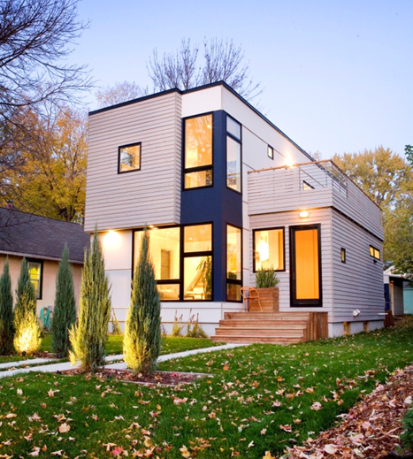
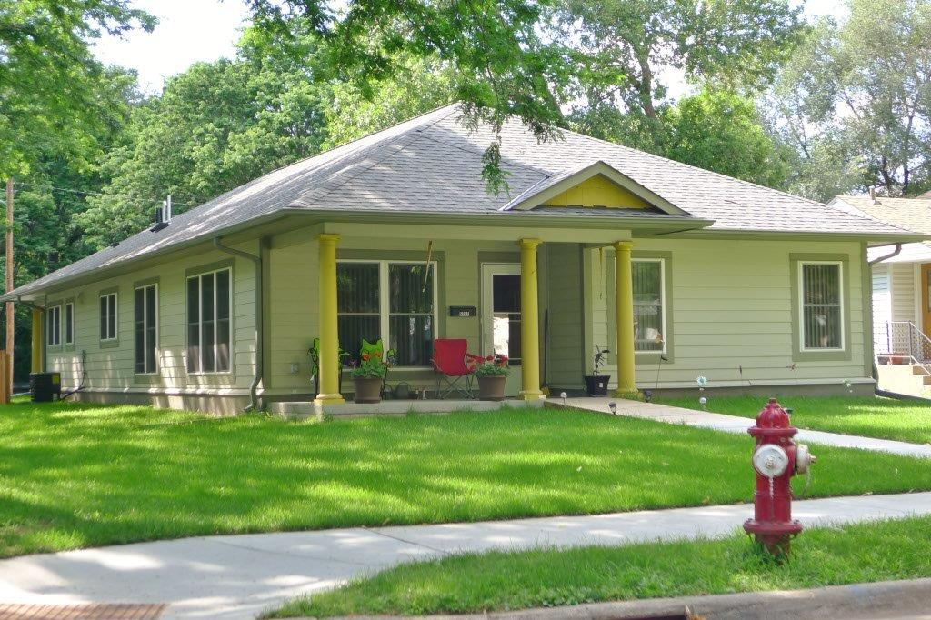
What is Minneapolis Homes?
Umbrella name for City of Minneapolis-sponsored scattered site housing products.
Access: Homebuyer Support
Homebuyer education and capacity building
Homeownership Opportunity Minneapolis (HOM) down payment assistance
Stabilization
9000 equities first mortgages
Create: Affordable homeownership units
City-owned property development
Minneapolis Homes: Financing
Sustain: Preserving homeownership
Foreclosure prevention counseling
Hennepin Homeownership Preservation Program
Home improvement loans
Notes:
Minneapolis Homes is an umbrella name for a variety of housing products. We provide Homebuyer supports – focused on improving access to home ownership Property – we manage city-owned land and offer it for sale to achieve City goals and Financing –we create new units of affordable ownership housing for homebuyers below 80% AMI, and help homeowners sustain their homes with home improvement loans.
My presentation today is going to be focused on our homeownersihip affordable housing financing products

Slide 11
Access: Homebuyer support
Education and mortgage support
Homebuyer education and financial wellness
9000 Equities program offers manual underwriting of first mortgages
Affordability assistance
Program | Partners | Assistance
Homeownership Opportunity Minneapolis: down payment assistance | Build Wealth Minnesota Neighborworks Home Partners | $10,000 households below 80% AMI $20,000 households below 60% AMI
Stabilization: perpetually affordable | City of Lakes Community Land Trust | $70,000+ households below 80% AMI
Notes:
14 different non-profit counseling agencies receive support through the City of Minneapolis and Minnesota Homeownership Center to provide homebuyer counseling and financial wellness credit building counseling in multiple languages.
People of color households have twice the denial rate for first mortgages as white households with a similar credit profile – Build Wealth Minnesota has created the 9000 equities program to provide first mortgage underwriting services that consider alternatives to credit scores, like on time rental payments, when underwriting someone for a first mortgage.
And finally we provide down payment assistance – up to $20,000 for a household to purchase a home that’s naturally affordable and on the market, and an average of $70,000 for homes for homes that require a deeper investment and enroll in a perpetually affordable housing model.

Slide 12
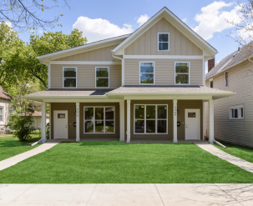
Create: Affordable homeowner units
Minneapolis Homes: Financing
1-20 unit ownership development
Three subsidy tiers, sized by bedroom size
Net zero ready standard and green communities standard
Ultra-efficient sustainability incentive
Notes:
There aren’t enough affordable homes on the market, so we also work with developers to build new opportunities. 75% of the developers in our program are people of color led.
Homes that we develop are sustainably built and encourage dense development of city land.

Slide 13
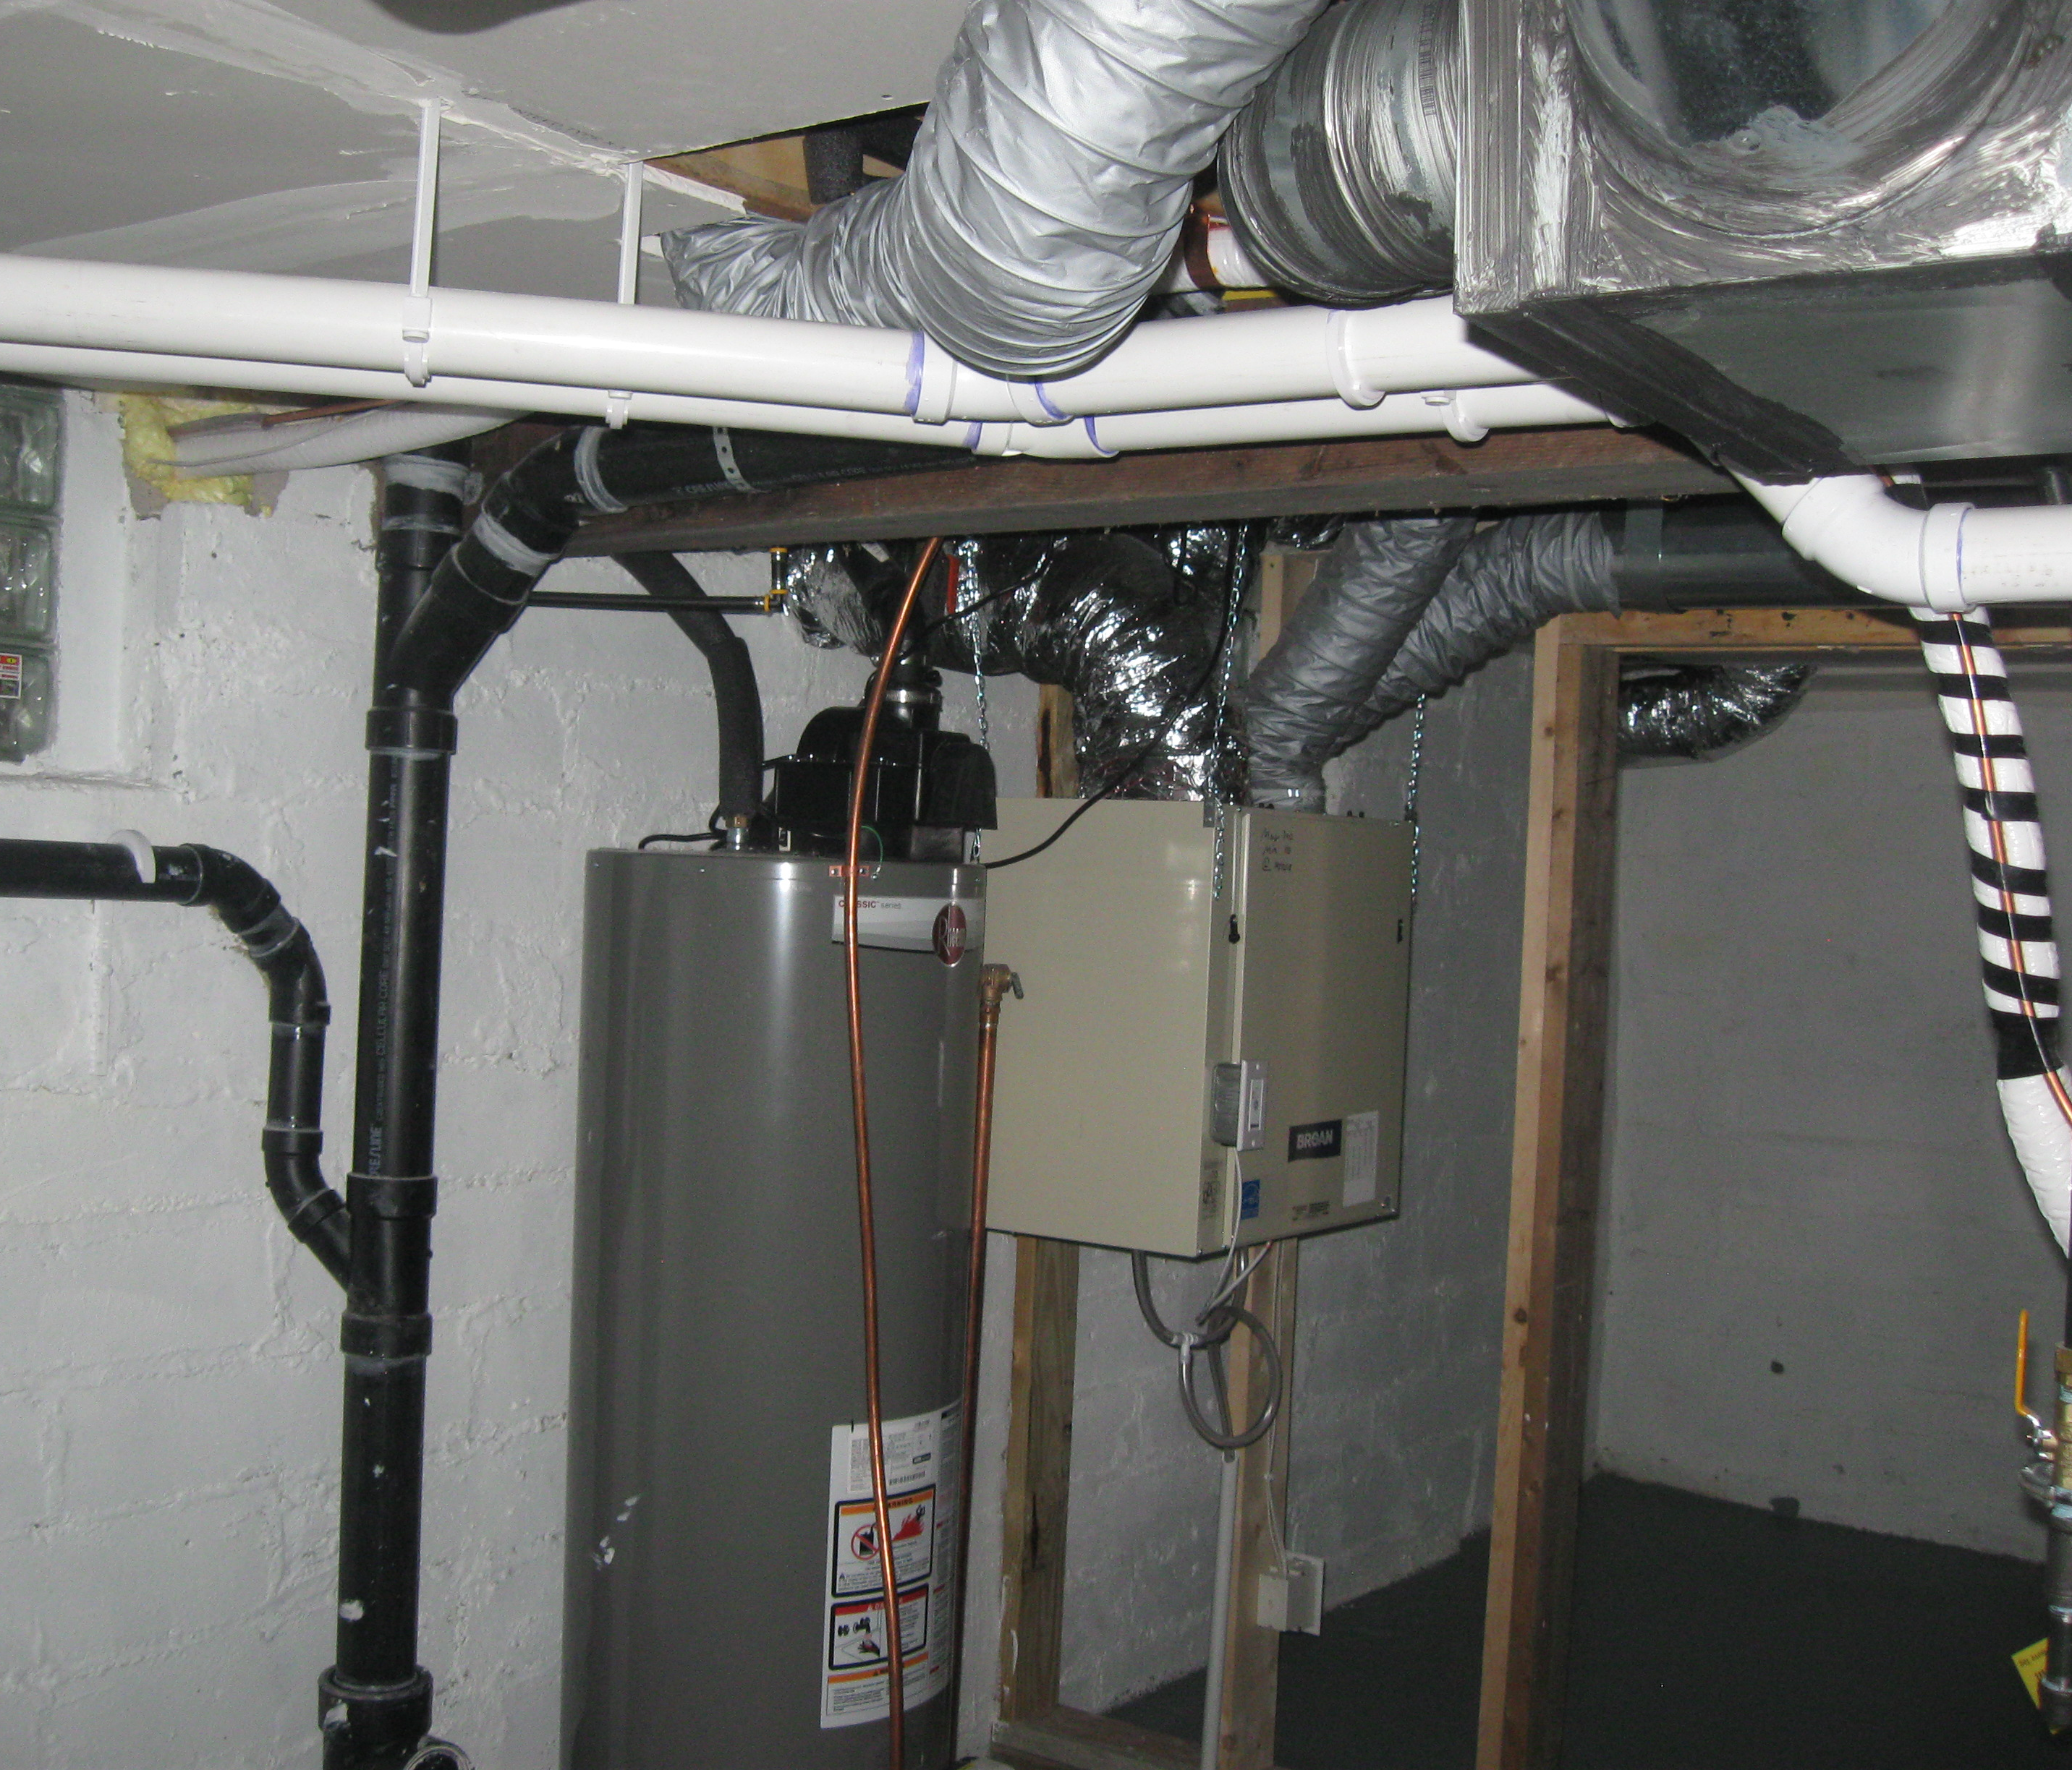
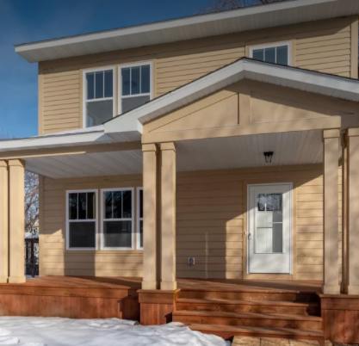
Sustain: Preserving homeownership
Home improvement
$1 million annual budget
Average 25 loans annually
Partnership with Health department for grants to address radon, energy, lead, and solar
Foreclosure prevention
Foreclosure counseling with no income limits
Direct assistance program to support households impacted by COVID-19
Notes:
We also need to keep the homeowners we have, so we have support through both home improvement loans and foreclosure prevention counseling.

Slide 14
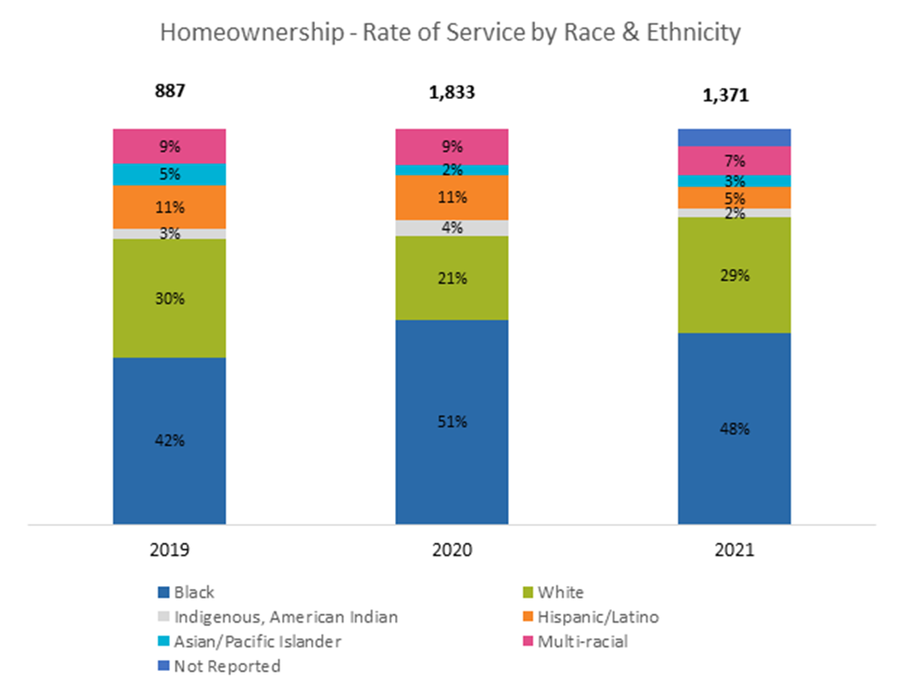
2019-2021 Minneapolis Homes Results
Notes:
Our program has an over 70% rate of service to people of color homebuyers and homeowners, and through our partners we hope to continue to grow our reach to eliminate racial disparities in homeownership.
Questions?

